Slide 1
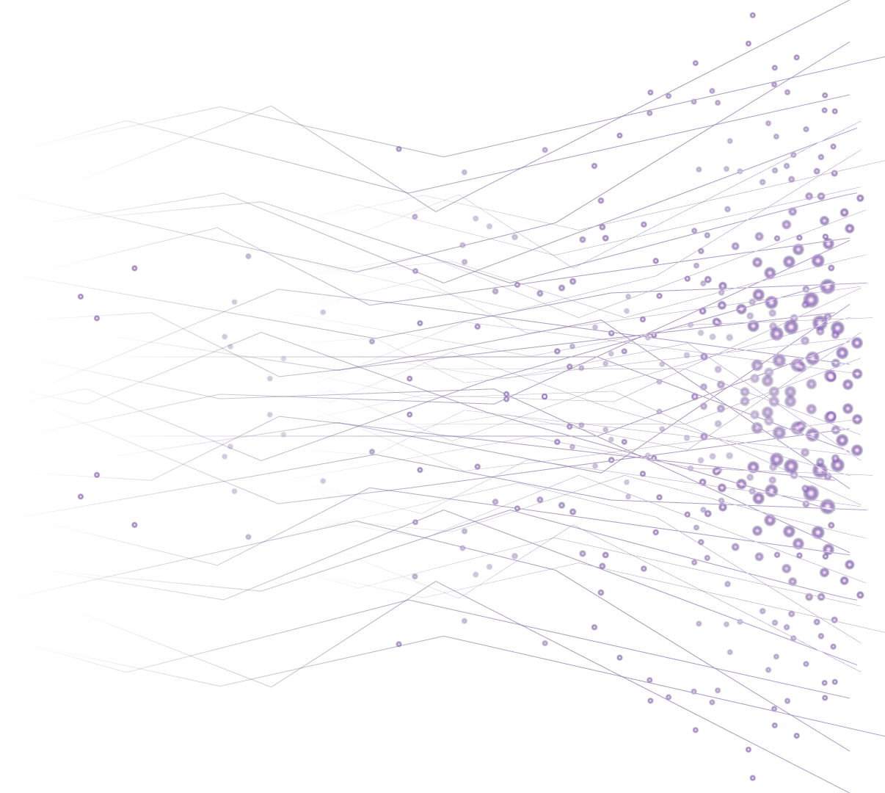

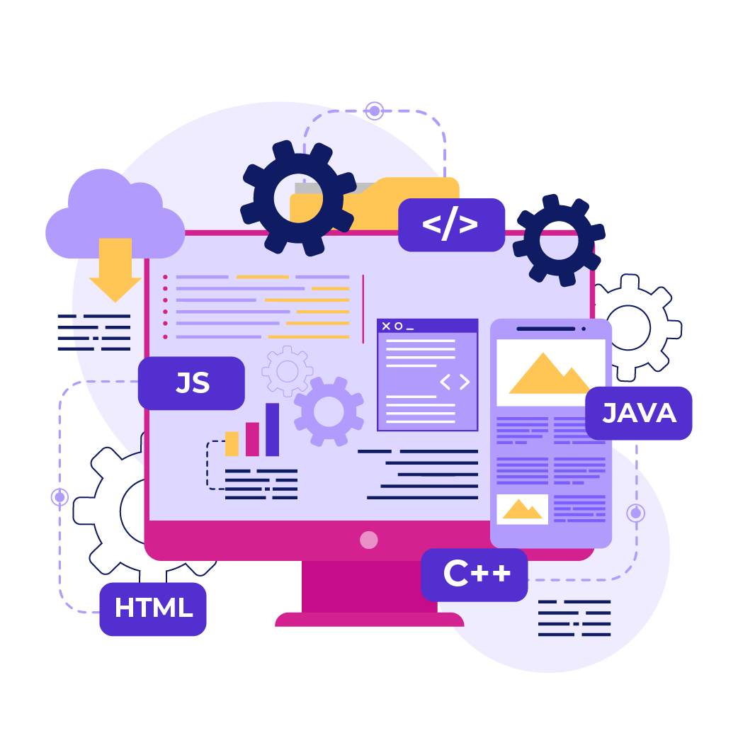
Introduction to
Computer
Programming

Slide 2

What is Cloud ?

Slide 3
Concept of cloud computing
Cloud computing is the delivery of computing services—like servers, storage, databases, networking, software, and more—over the internet ("the cloud"), rather than using your local computer or a private data center.
Key Concepts
You can access resources whenever needed without owning hardware.
You can easily scale up or down based on your demand.
You pay only for what you use (like a utility bill).
a) On-Demand Access
b) Scalability
c) Pay as-you-go

Slide 4
Why companies use the cloud ?
Reason 1: Cost Savings
No upfront hardware costs – You rent infrastructure instead of buying servers.
Pay-as-you-go – Only pay for the resources you actually use.
Lower maintenance costs – Cloud providers handle updates and hardware.
Reason 2: Scalability & Flexibility
Instantly scale up or down based on demand.
Useful for handling traffic spikes or business growth without downtime.

Slide 5
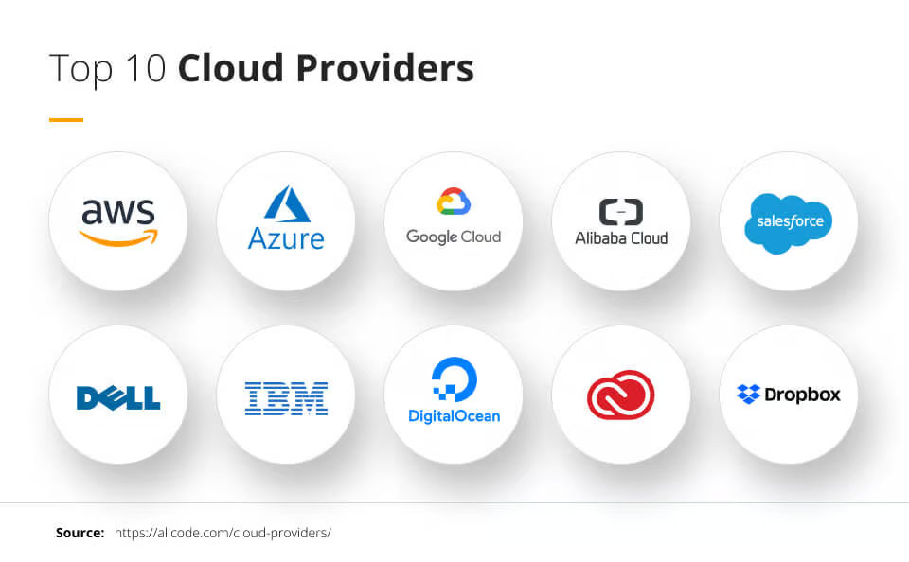
Why companies use the cloud ?
Reason 3: Faster Time to Market
Quickly deploy applications and services without lengthy setup times.
Pre-built tools and platforms (like AWS Lambda or Google Firebase) speed up development.

Slide 6
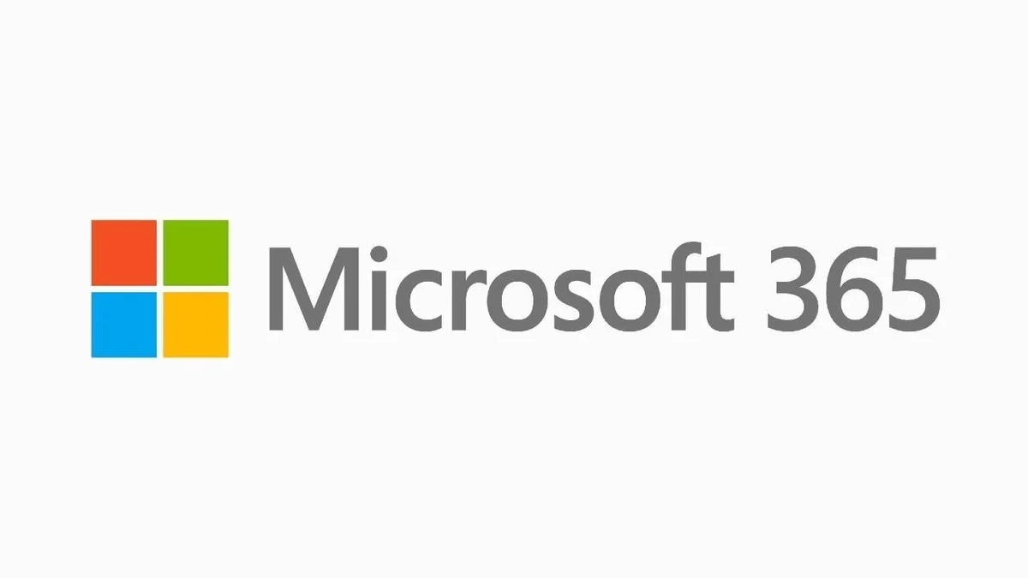
What are cloud service models
SaaS – Software as a Service
Delivers software applications over the internet, fully managed by the provider.
Examples:
Google Workspace (Docs, Sheets, Gmail)
Salesforce
Microsoft 365

Slide 7
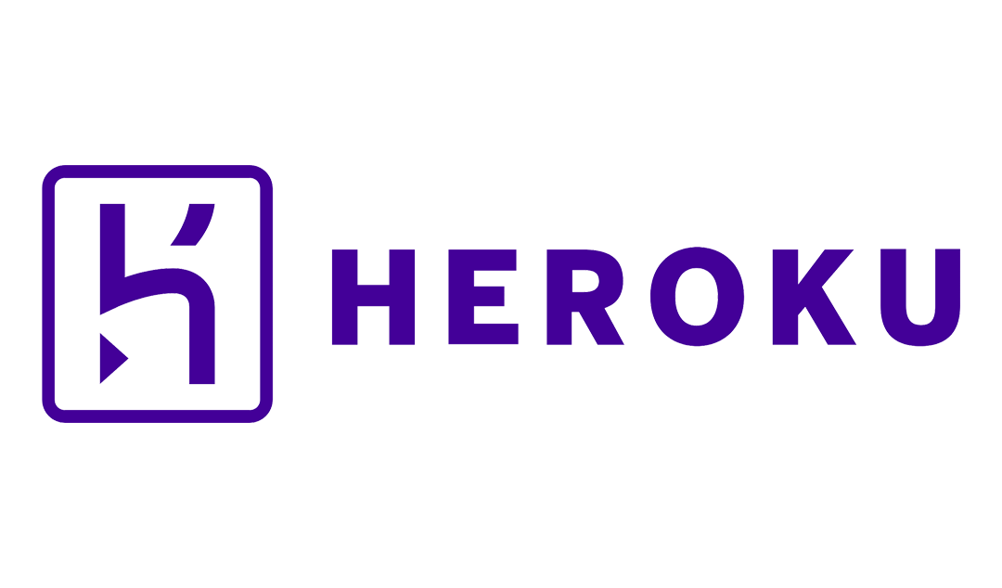
What are cloud service models
PaaS – Platform as a Service
Provides a platform for developers to build, run, and manage apps without managing the underlying infrastructure.
Examples:
Google App Engine
Heroku
Microsoft Azure App Service

Slide 8
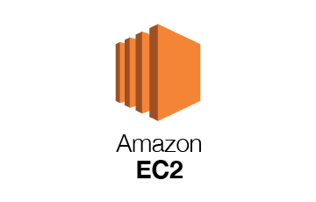
What are cloud service models
IaaS – Infrastructure as a Service
Provides basic computing infrastructure – servers, storage, networking – on demand.
Examples:
Amazon EC2 (AWS)
Google Compute Engine
Microsoft Azure Virtual Machines

Slide 9
Popular Cloud Providers
Amazon Web Services (AWS)
Market leader in cloud computing.
Offers 200+ services including compute (EC2), storage (S3), and AI tools.
Strengths: Scalability, global presence, massive ecosystem.
Microsoft Azure
Strong in hybrid cloud and enterprise integrations (especially with Microsoft 365 and Windows Server).
Offers services like Azure Virtual Machines, App Services, and Cosmos DB.
Strengths: Enterprise-friendly, good for .NET and Windows developers.

Slide 10
THANK YOU

